Slide 1

CHURN PREDICTION MiniHackathon IBM VIETNAM - VIB Hackathon 2021 Le Cong Nguyen

Slide 2
Contens
Introduction
Customer churn
Prediction Engineering
Feature Engineering
Modeling
Conclusions

Slide 3
01
Introduction
Menu

Slide 4
VIB wants to come up with an innovation for making use of their existing data to improve the mobile banking customer experience.
VIB is excited about the out-of-the-box ideas that can determine factors that make our customers leaving the MyVIB mobile application.
→ Definition of customers who leave MyVIB app

Slide 5
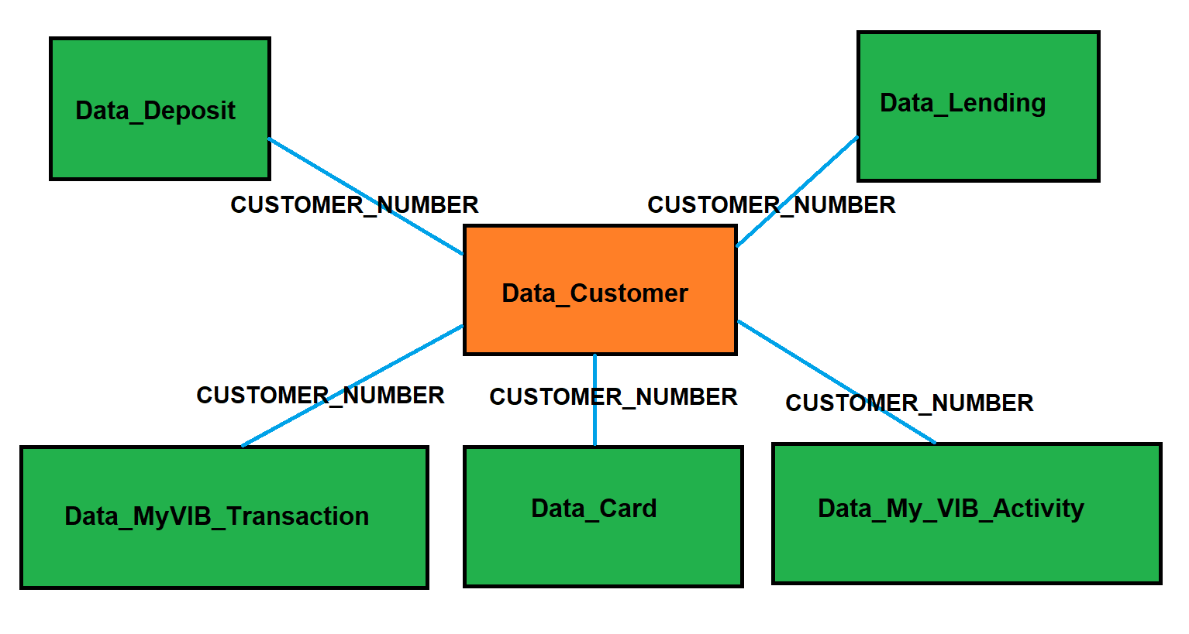
Structured, relational data: observations in the rows, features in the columns, and tables tied together by primary and foreign keys: the CUSTOMER_NUMBER

Slide 6
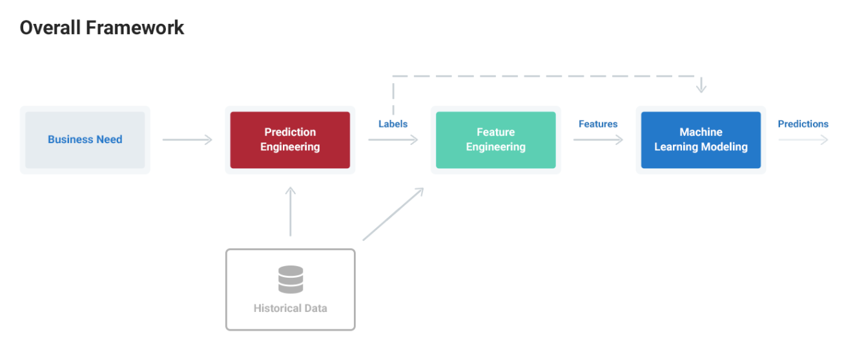

Slide 7
The general machine learning framework is outlined below:
Prediction Engineering: State the business need, translate into a machine learning problem, and generate labeled examples from a dataset
Feature Engineering: Extract predictor variables, features from the raw data for each of the labels
Modeling: Train a machine learning model on the features, tune for the business need, and validate predictions before deploying to new data

Slide 8
02
Customer churn
Menu

Slide 9
Define churn as customers who have not made a activity in the last 30 days
Accurately predicting if and when customers will churn lets businesses engage with those who are at risk for unsubscribing or offer them reduced rates as an incentive to maintain a subscription
→ Making predictions about customer churn on the first of each month

Slide 10
03
Prediction Engineering
Menu

Slide 11
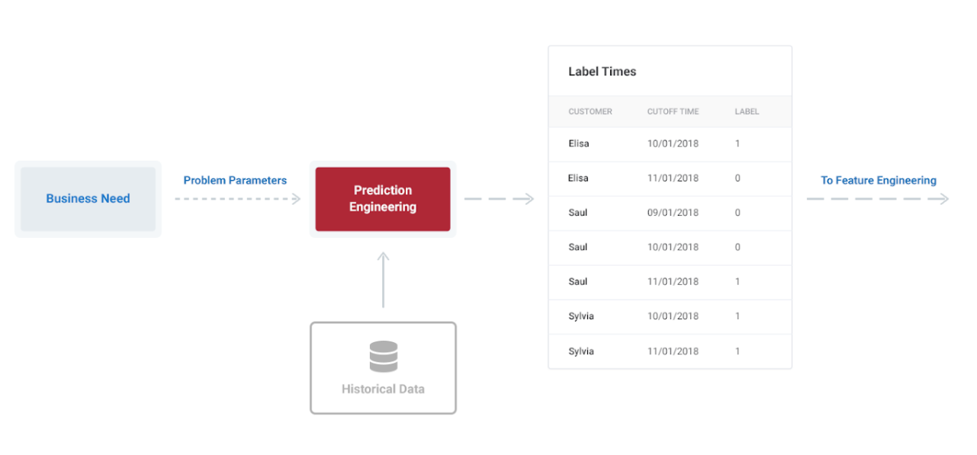
A time-dependent problem
Making labels to train a supervised machine learning model
The output is a Label Times table

Slide 12
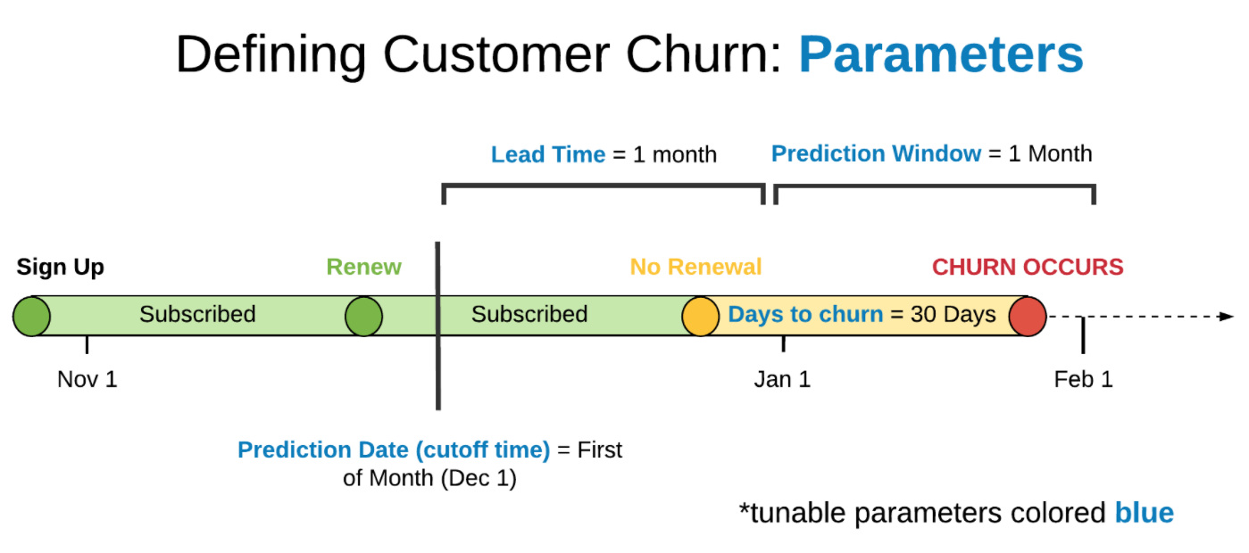

Slide 13
For customer churn, the parameters are the
1. prediction date (cutoff time): the point at which make a prediction and when stop using data to make features for the label.
- Cutoff times are a crucial part of building successful solutions to time-series problems
- Making predictions about customer churn on the first of each month
- All the features for each label must use data from before this time to prevent the problem of “data leakage”.
2. number of days without a activity before a user is considered a churn
3. lead time: the number of days or months in the future want to predict, make predictions “lead time” in advance
4. prediction window: the period of time want to make predictions for
Notes:
Data leakage: Là hiện tượng xuất hiện khi dữ liệu chúng ta sử dụng khi training không có sẵn khi thực hiện inferring; hoặc chúng ta lấy thông tin về dữ liệu validation/test set để đem vào training set.

Slide 14
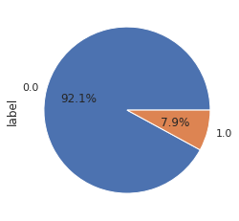
Label Distribution with Monthly Predictions and days to churn = 30
0: 389,814
1: 33,580 (churn)
time processing ~ 35’
cutoff_time churn_rate
2019-01-01 14.31
2019-01-02 12.75
2019-01-03 12.63
2019-01-04 10.42
2019-01-05 12.05
2019-01-06 56.93
2019-01-07 4.75
2019-01-08 9.26
2019-01-09 8.73
2019-01-10 7.46
2019-01-11 4.32
2019-01-12 0
2020-01-01 0

Slide 15
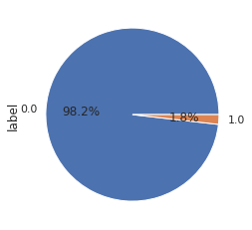
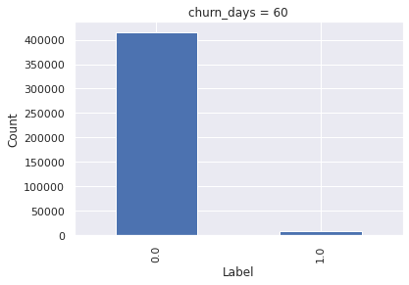
Label Distribution with Monthly Predictions and days to churn = 60
0: 415,747
1: 7,647

Slide 16
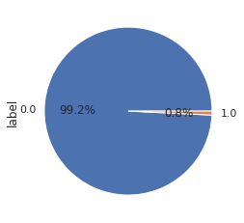
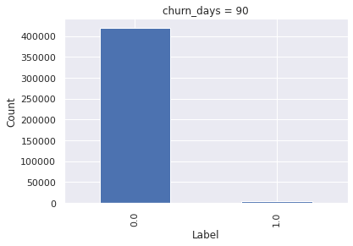
Label Distribution with Monthly Predictions and days to churn = 90
0: 420,165
1: 3,229

Slide 17
04
Feature Engineering
Menu

Slide 18
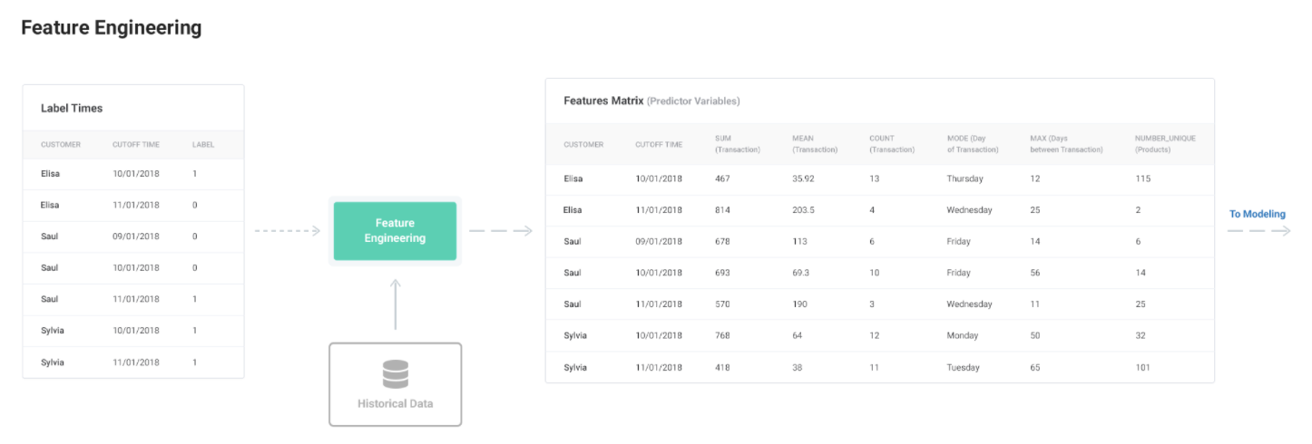

Slide 19

The process of extracting features from a raw dataset
Featuretools is a framework to perform automated feature engineering. It excels at transforming temporal and relational datasets into feature matrices
The heart of the library is Deep Feature Synthesis algorithm
Input: is a set of entities, a list of relationships, and the “target_entity” to calculate features for. (Each table is called an entity)
Ouput: is a feature matrix and the corresponding list of feature definitions.

Slide 20
BUT RAM overflow on Google Colab ☺
-> Manual Feature Engineering
- before cutoff time for each label
- Create new variables based on domain knowledge by primitives: sum, mean, avg, diff…
- Identifying outliers with the 1.5xIQR rule…
- Missing values, error data…

Slide 21
05
Modeling
Menu

Slide 22
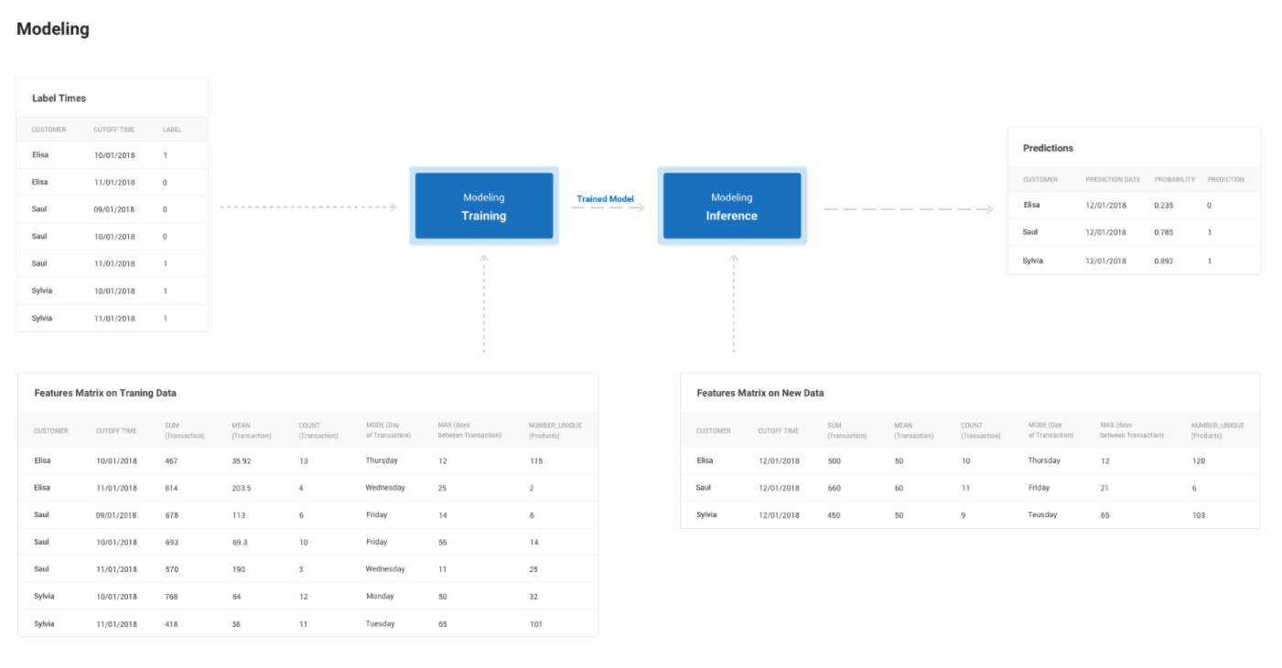
Teaching a Machine Learning Algorithm to Deliver Business Value
The objective of machine learning is not a model that does well on training data, but one that demonstrates it satisfies the business need and can be deployed on live data.

Slide 23
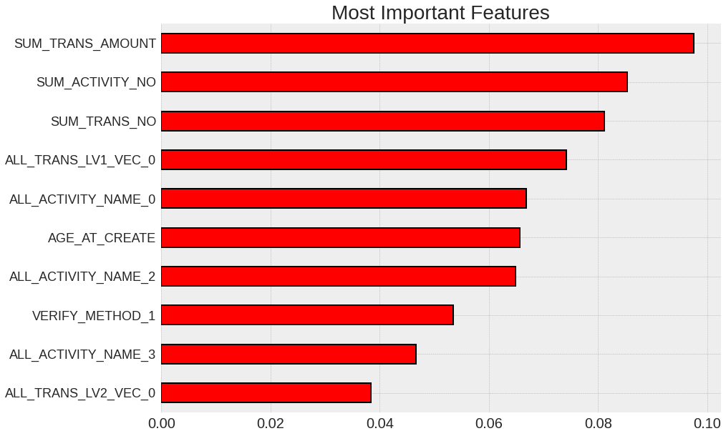
The 10 most important variables

Slide 24
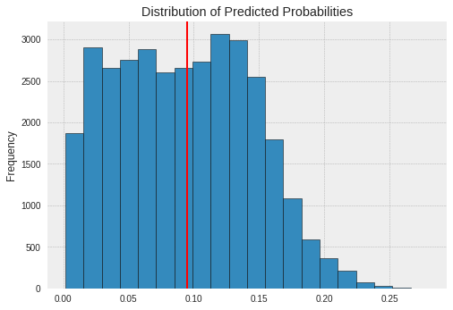
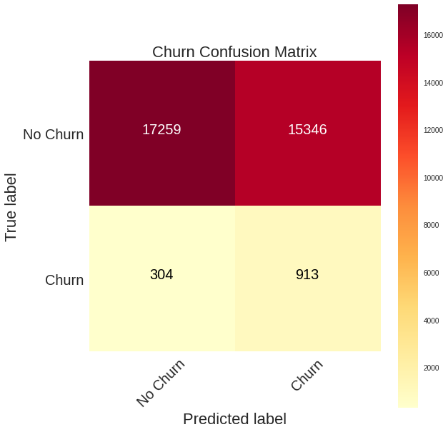
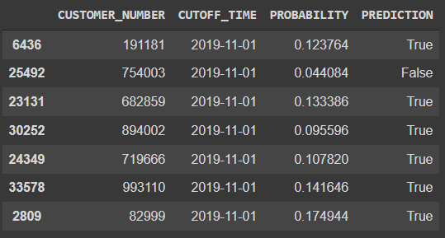
Making Predictions and Deployment

Slide 25
Business Value Analysis…
Automated Model Optimization Using TPOT…

Slide 26
06
Conclusions
Menu

Slide 27
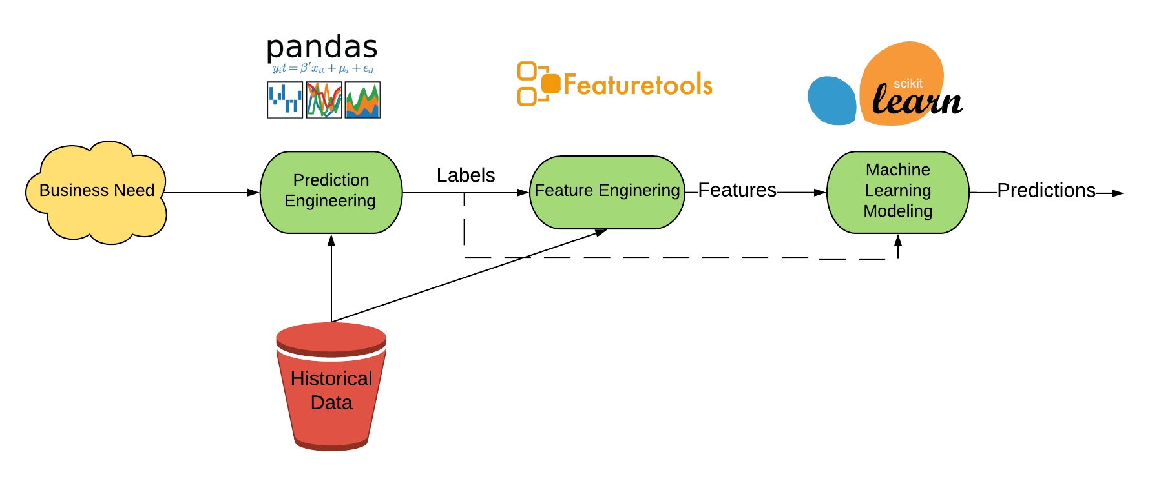
Future work:
Use all data table
Create more new variables
Automated Feature Engineering
…

Slide 28
THANK FOR YOUR ATTENTION!

Slide 29
References - https://github.com/Featuretools/predict-customer-churn/tree/master - https://github.com/pareshg18/Predicting-Customer-Churn

